Slide 1
Sale Price Prediction of Housing in AMES
Preety Bhogal

Slide 2
Problem Statement
Predicting the sale prices of residential housing in AMES, Iowa using advanced regression techniques and machine learning algorithms.

Slide 3
Data Overview
Train and test housing datasets consist of sale transactions of housing units in AMES, Iowa between 2006 and 2010.
Training dataset – 2051 observations, 81 columns/features
Test dataset – 879 observations, 80 columns/features (the dependent variable – Sale Price is not included here)

Slide 4
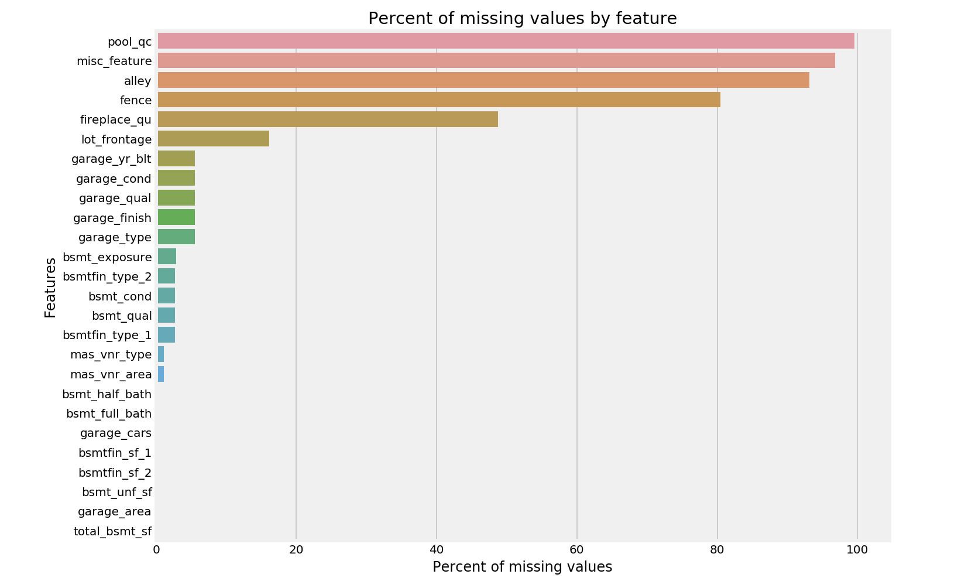
Data Cleaning and EDA
Finding the null/NaN values and replacing it with the appropriate numbers.

Slide 5
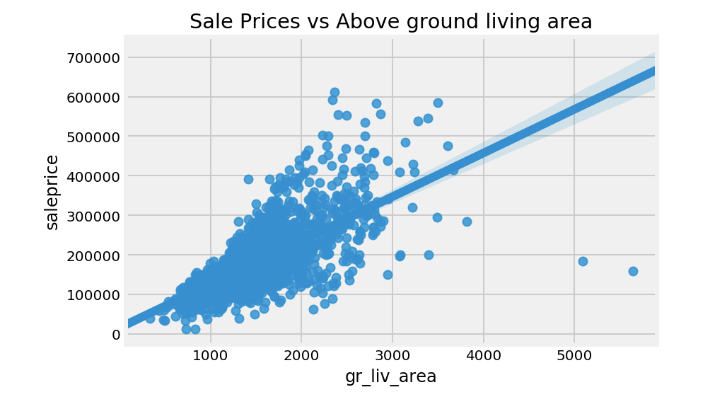
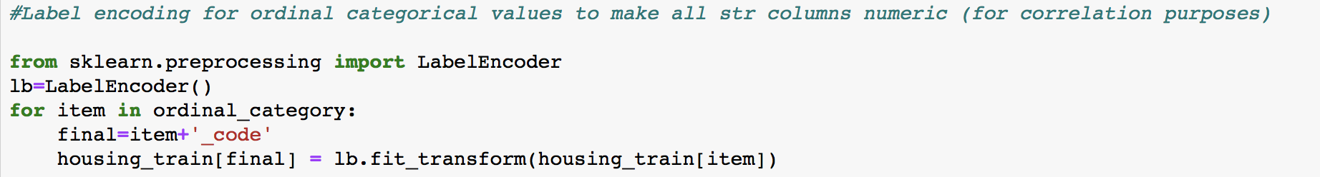
Removing outliers from variables in the train dataset such as greater living area.
Doing label encoding for some ordinal categorical variables.
Doing one-hot encoding for nominal categorical variables.

Slide 6
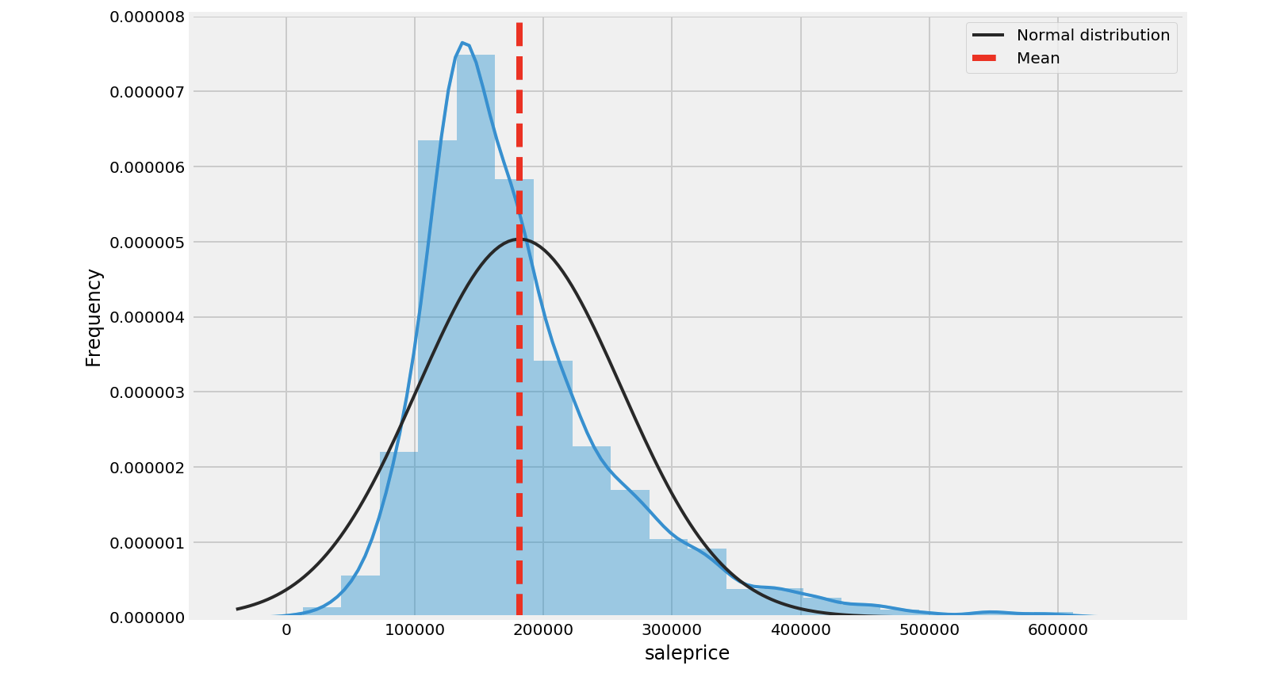
Target Variable – Sale Price
Sale Price variable is positively skewed.
There are greater number of houses with lower sale price. Mean of the distribution is on the right tail.

Slide 7
Model Fitting and Evaluation
Fitted four models on the train dataset and tested on the validation set.
4 models are – Linear Regression, Ridge Regression, Lasso Regression, and ElasticNet Regression.
ElasticNet model gave the highest R-squared value and lowest mean-squared error. Thus, it was chosen to be tested on the actual housing test dataset.
Few explanatory variables were selected with highest and lowest ElasticNet coefficients to create a balanced subset. This subset was re-trained with ElasticNet model and predictions were made for the actual housing test dataset.

Slide 8
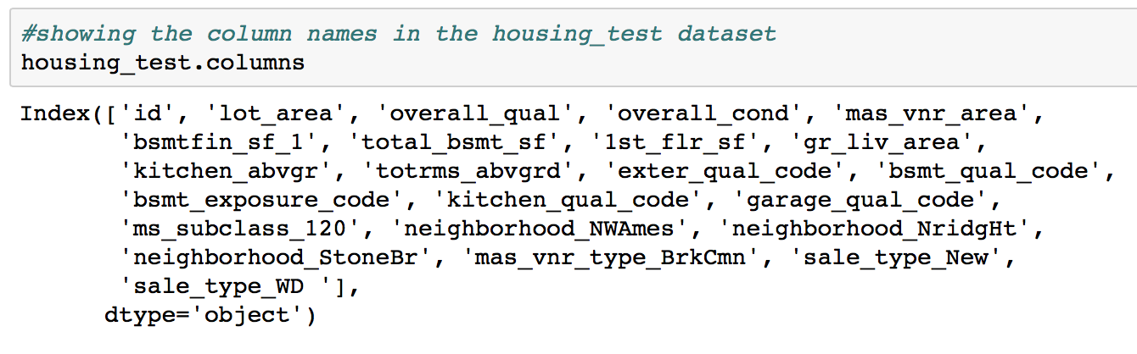
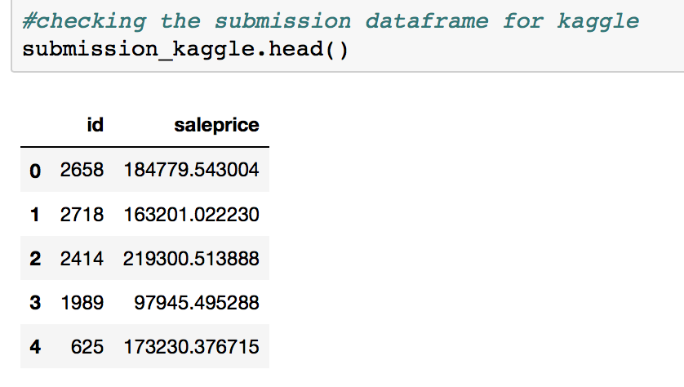
Conclusion and Recommendations
Few neighborhoods such as NridgHt, StoneBr have a significant influence on sale prices.
Overall quality, external quality, basement quality, greater living area (big houses) tend to have a direct association with sale prices.
Recommendation – Property owners should look for building houses in some neighborhoods that have a high sale prices.

